Slide 1

(Non Technical) Overview of Deep Learning Object Detection on 3D Lidar Points
Han Bin Lee
Seoul Robotics

Slide 2
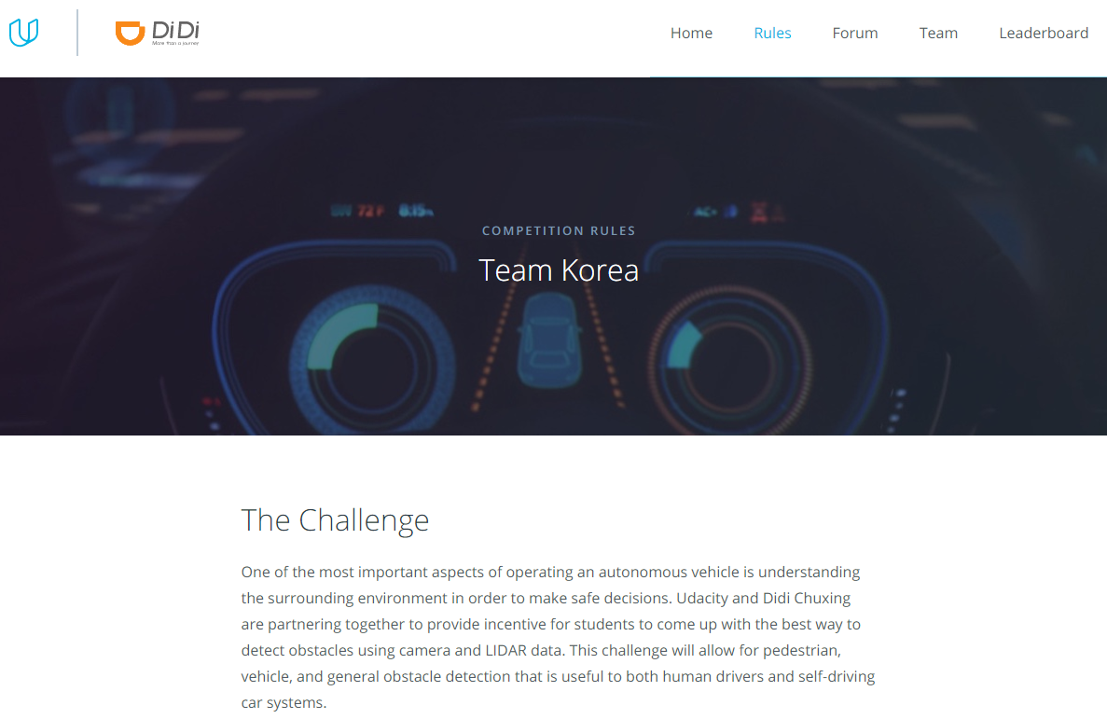
Prelude
How it all got started
Udacity
2017 Didi-Udacity Challenge

Slide 3
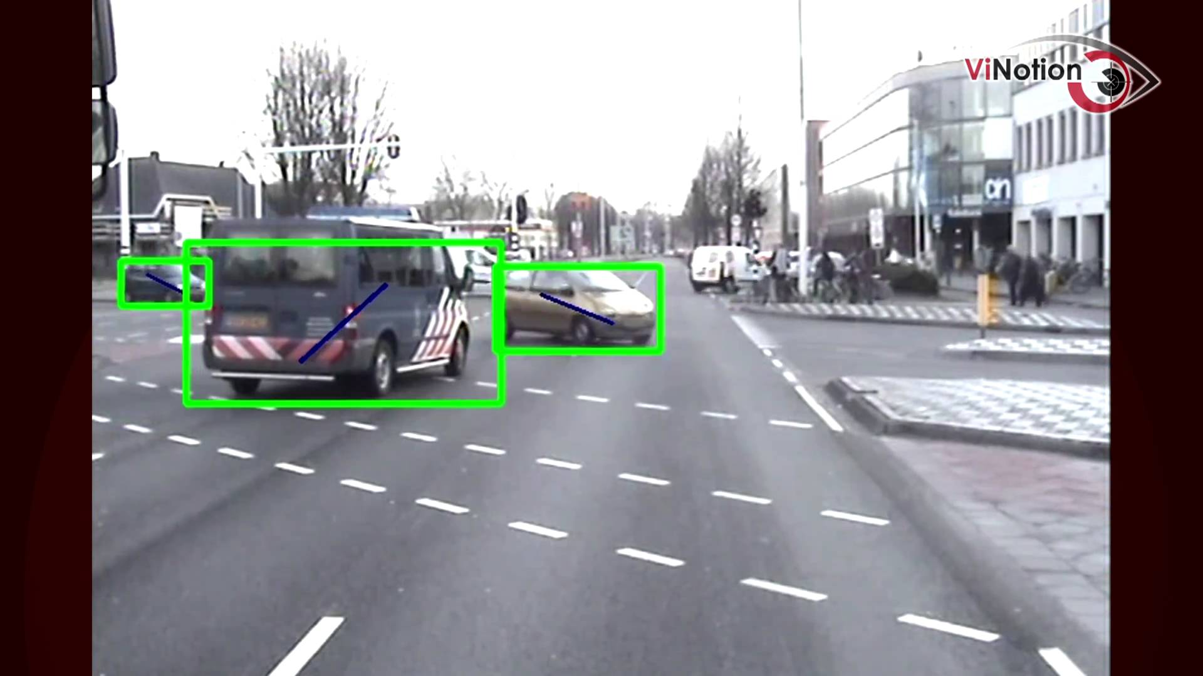
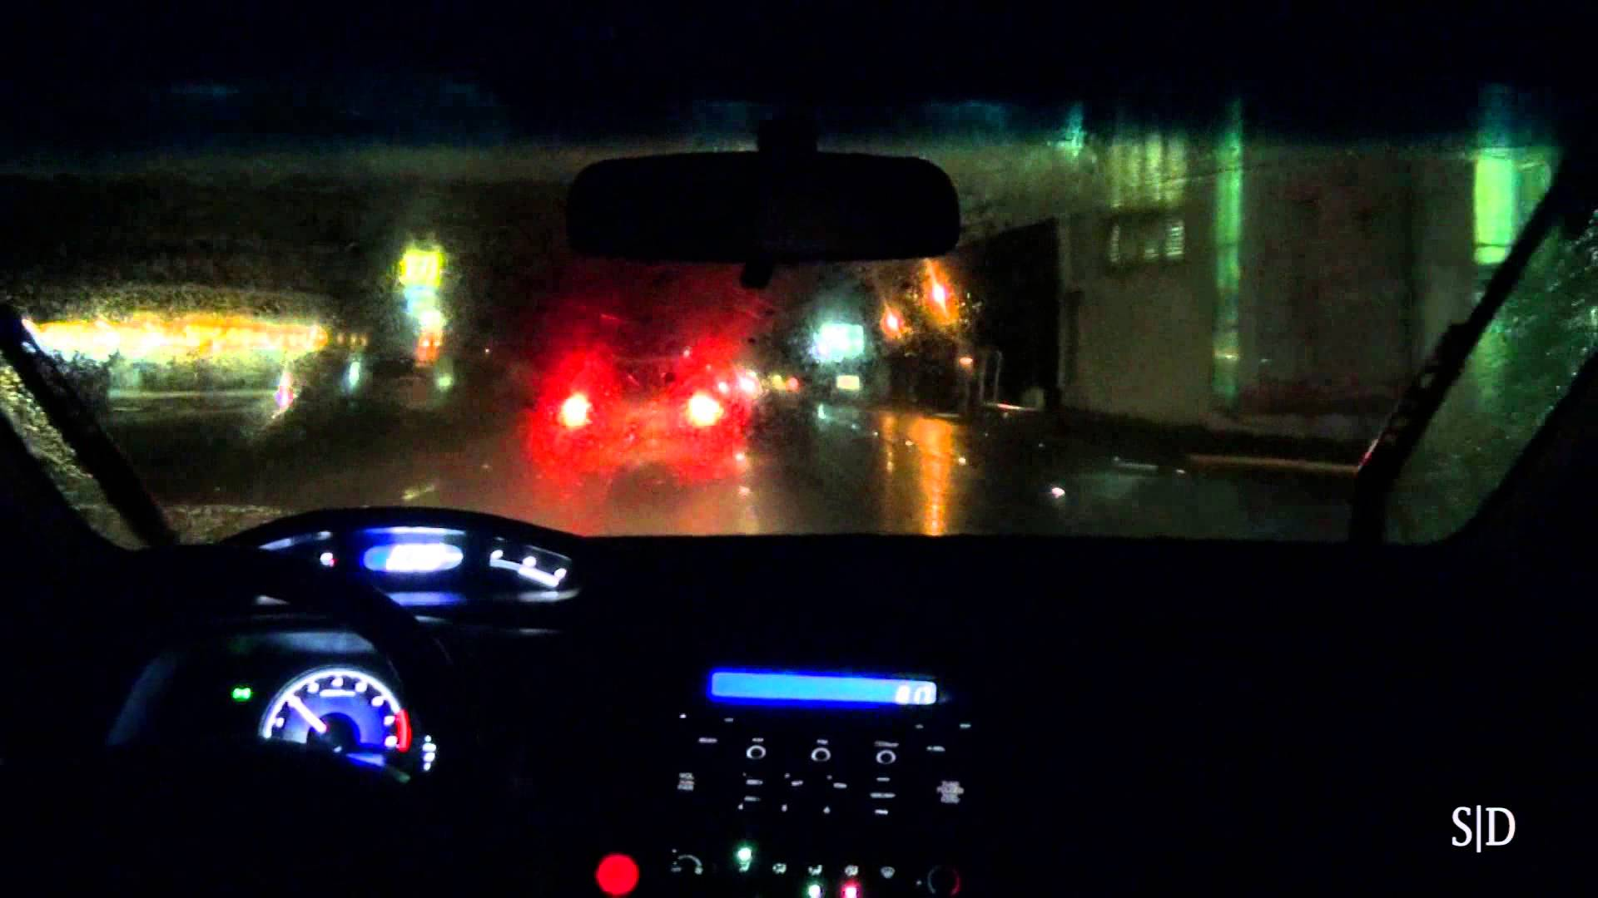
Object Detection overview
Limitation of Camera
Need for Lidar

Slide 4
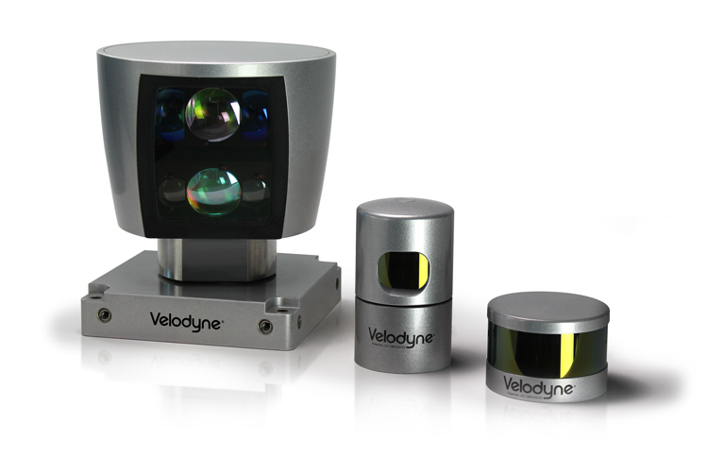
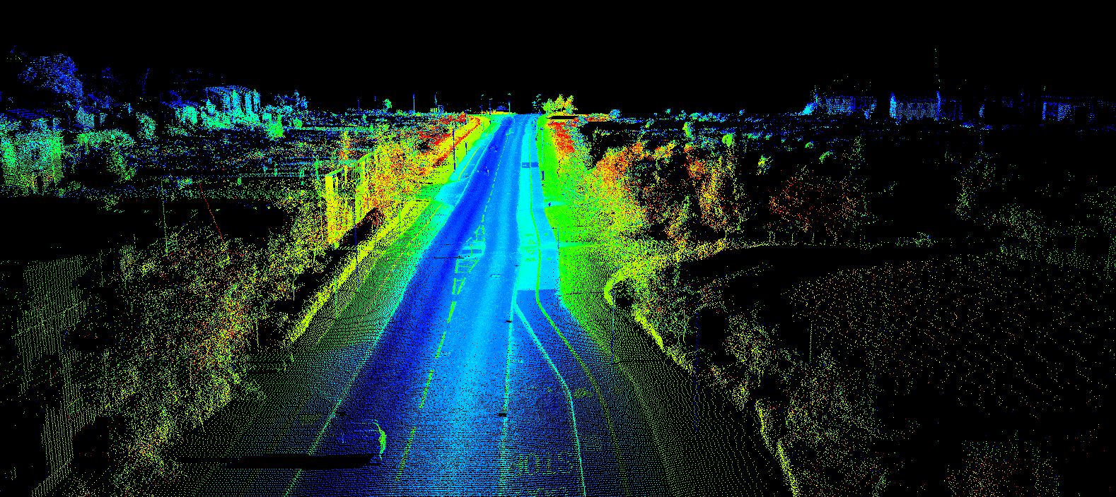
Basic Structure of Lidar
4 by n
x y z R + timestamp

Slide 5
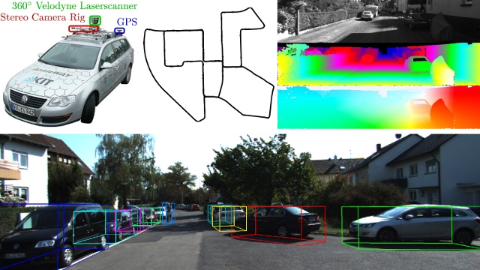
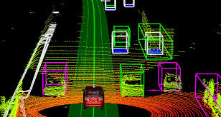
Big Data Used
Kitti data set
Udacity data set
All labeled and annotated

Slide 6

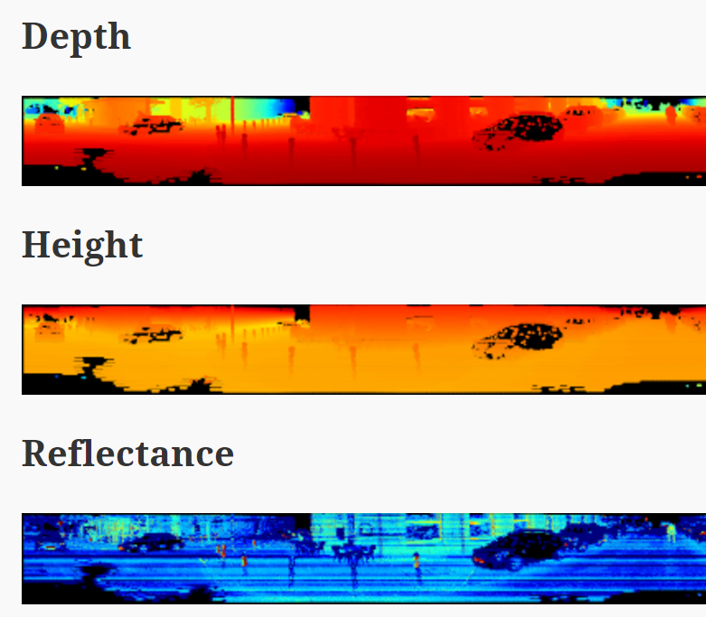
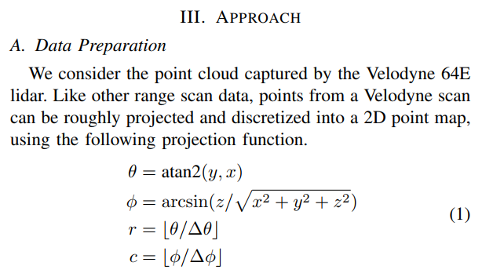
Training Data Transformation
2D panoramic transformation
Any points within annotated box was the ‘car’

Slide 7
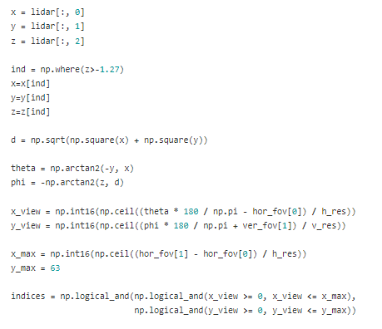
Python Implementation of 2D transpose

Slide 8
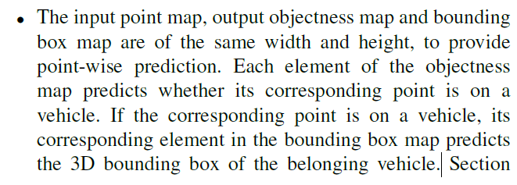
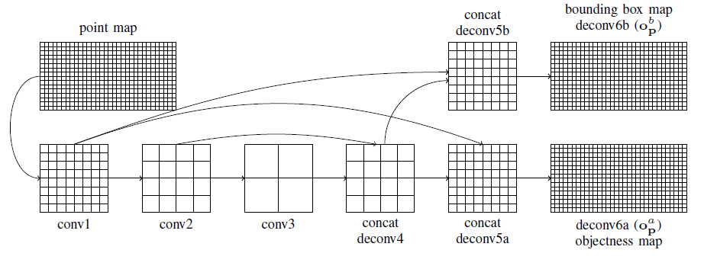
The Deep Learning Structure

Slide 9
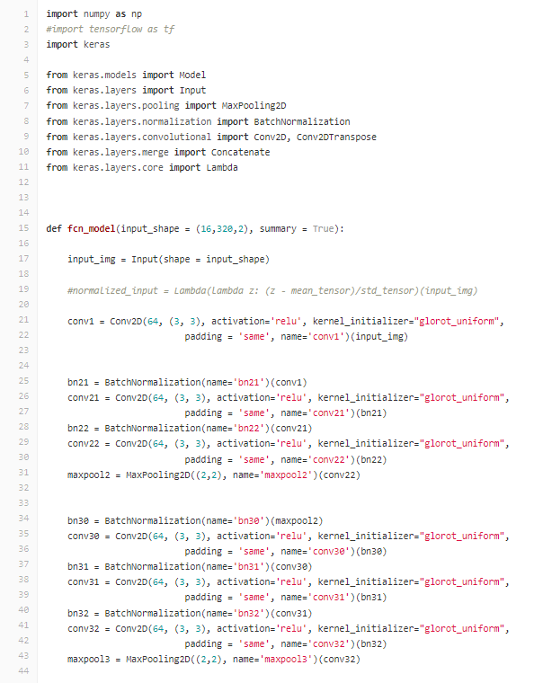
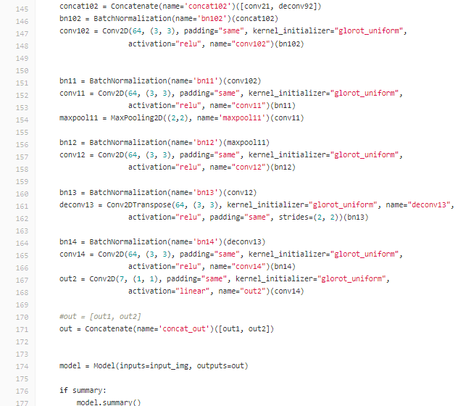
Fully Convolutional Net
Fully Convolutional Network

Slide 10
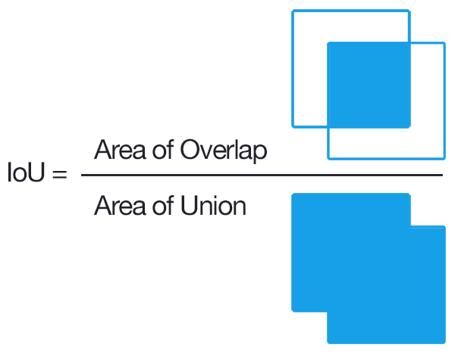
Measurement of Accuracy
Intersection over union value

Slide 11
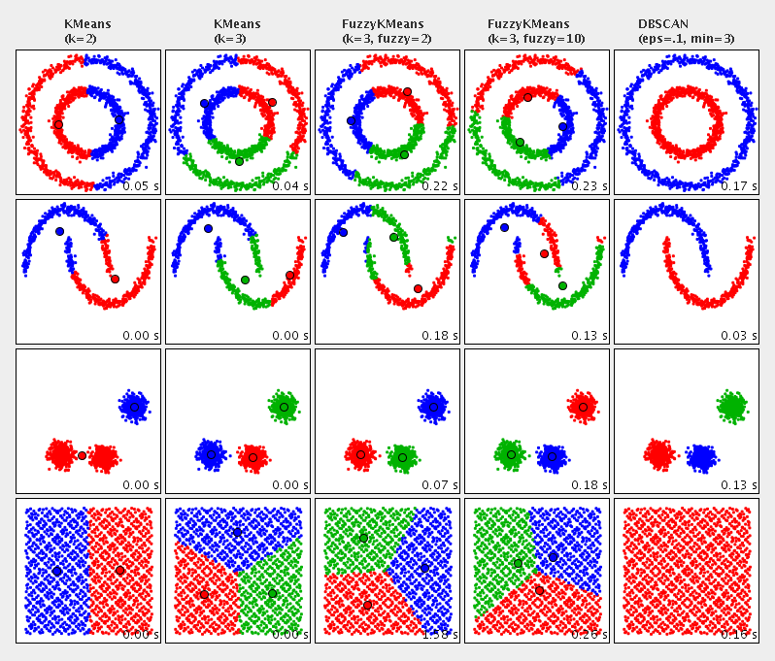
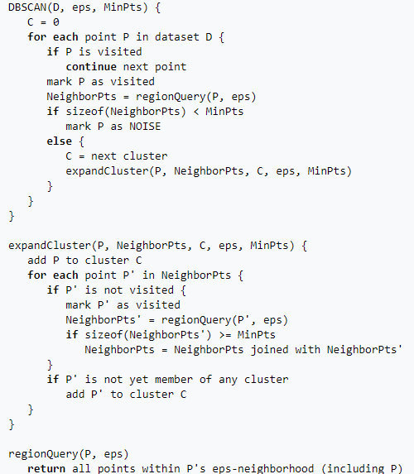
Some other Technique used
DBSCAN Cluster method

Slide 12

Team Korea’s Result
10th out of 2000

Slide 13
After Thought
Data data data data
Limit of panoramic view – perhaps birds eye view was better
Data data data data
Need to be fast ~ 20hz

